Slide 1
DOS attack Detection using reinforced machine learning
BAo

Slide 2

Background:
massive datasets generated by researches and scientists for projects like the large hadron collider, teragrid....Etc.
Gbps speeds over networks spanning continents for high-speed computing.
Requirements: low latency, high availability …etc.
Sdns and cloud computing have somewhat similar requirements.
Need active measurements and analysis to identify and analyze them.

Slide 3
Perfsonar:
Test and measurement infrastructure used by universities, scientific institutions, laboratories to monitor and ensure network performance.
Provides federated coverage of paths and end to end usage statistics.
Uniform interface, scheduling of measurements, uniform data formats, scalable.
Offline and online analysis possible.

Slide 4
How does this actually work?
Query Perfsonar database for network statistics between 2 hosts/sites.
Specify time and data type.[owamp, bwctl, traceroute, packet loss etc].
Remove/normalize anomalies.
Generate statistics to reduce datasets(Max,min,median).
Compute mean and standard deviation.

Slide 5
PSEUDO CODE FOR DATA_RETRIEVAL:
Input_source =config_file(input); statistics[standard_dev] = raw_data.std_dev;
Output_source = config_file(output); statistics[mean] = raw_data.mean;
Event_type – config_file(event_type); statistics[minimum] = raw_data.minimun;
Set time_duration; statistics[median] = raw_data.median;
Api_connect(perfsonar/esmond backend); json_list2.append[statistics];
Connection = Api_connect(perfsonar_backend); save(json_list1,json_list2);
for meta_data in conncection.get_meta_data;
et = meta_data.get_event_type;
dp = et.get_data;
raw_data[time] =et.get_time;
Raw_data[value] = et.get_value;
jsonlist1.append(raw_data);

Slide 6
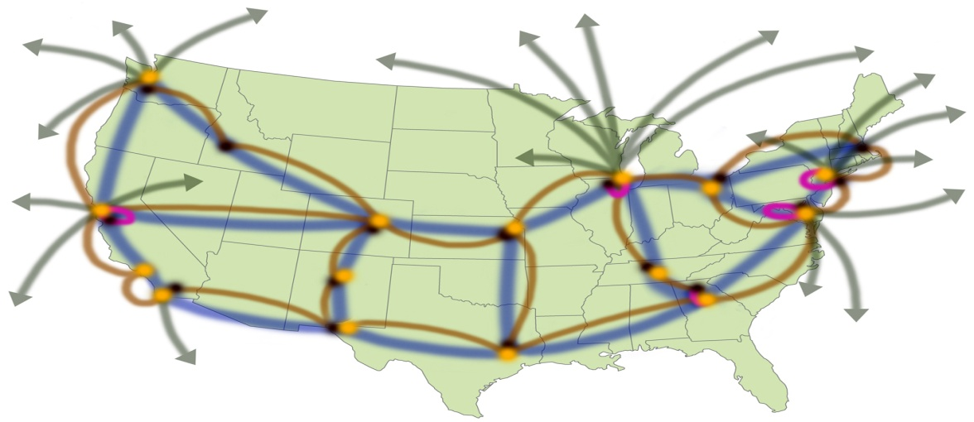
Non-PerfSONAR Protocols
Visualization
SNMP MIB logs/traps
Routing databases (OSPF, BGP)
NetFlow records
Filtering/
Pre-processing
Anomaly
Detection
Anomaly
Localization
Diagnosis/
Classification
(RCA)
Measurement Traces (Active)
perfSONAR
repository
OWAMP
BWCTL
Traceroute
Loss

Slide 7
What to do with the data?
Perform offline and/or real-time analysis.
observe patterns and behaviors in the data generated to localize anomalies, faults etc.
resolve issues identified during analysis.
use the data to train program to speed up the process and make it more reliable in the future.

Slide 8
How do we do this?
Automated techniques and programs to identify these anomalies and notify concerned institutions in a timely manner.
Utilize statistical and machine learning techniques.
requirements: ease of implementation, low complexity, fast processing, reliable results.

Slide 9
Anomaly detection using machine learning:
Multiple techniques available to identify anomalies like wavelet analysis, kalman filter etc.
Plateau detection one of the more popular techniques for large scale network analysis.
Most use static configuration of ”sensitivity” and ”Threshold” parameters making them unsuitable for the dynamic and large scale networks being used in this case.
They generate a lot of false positives.

Slide 10
Solution!
Adaptive plateau detection algorithm.
Dynamically configure thresholds for sensitivity and trigger elevation parameters.
Guides the learning based on partially available Markov Decision Processes(discrete time stochastic control process ).
Measurements after anomaly provide intelligence and aid the reinforcement of the machine learning algorithm.

Slide 11
How the system looks:
Sample Buffer
trig_cnt++
ED
xt
Checker
trig_cnt++
Solver
EI
NE
Quarantine Buffer
s
swc
td
Summary Buffer
trig_cnt-- if trig_cnt=!0

Slide 12
State and state transitions:
NE
TE
trg_cnt < 0.75td
timer = swc
timer <swc, trig_cnt<0.75td
timer =!0, trig_cnt<0.75td
timer =0, trig_cnt<0.75td
timer = on,trig_cnt = 0
trg_cnt = 0.75td
trg_cnt = 0.75td
EI
ED
trg_cnt = td

Slide 13
Pseudo code for PD algorithm:
push sample to sum_buff;
func(running_stats);
if trig_cnt > 0;
reduce trig_cnt by 1;
update sum_buff;
if trig_cnt > 0.75 and trig_cnt< td;
no_action;
if trig_cnt = td;
update t_sl, t_ul;
enter event impeding state;
else:
if sample > t_su;
increment timer, num_detect,detet_times,
ts_l=1.2*(max_value_of_trig_buff);
ts_u = 0.8*(max_value_of_trig_buff);
if timer =swc;
return to initial state;
update mu_sum_buff, std_sum_buff;
tem_track[i] = mu_sum_buff;
plot(tmp_array,temp_track)
temp_array = json_list2[median, minimum];
num_sum = len(temp_array);
if num_sum < minimum_input_samples;
print”Error”
set swc,sensitivity,trigger_value,trigger_cnt;
sum_buff = temp_array.median;
mu_sum_buff = sum_buff.mean;
std_sum_buff = sum_buff.std;
last_detect,timer,num_detect = 0;
temp_track = temp_track[median,minimun,time];
func(running_stats);
t_sl =mu_sum_buff –sens*std_sum_buff;
t_su =mu_sum_buff + sens*std_sum_buff;
for i in range(swc,len(temp_array));
sample = i value of tem_array[median];
if last_detect is 0;
if sample < t_sl;
no event;(event =anomaly detected

Slide 14
Applications:
High speed computing and networking. Analysis of DOS, maliciousness, flash crowds etc.
SDN and NFV can utilize such an algorithm to identify threats and quickly utilize available resources to mitigate them.
Medium to Large Scale enterprise networks.

Slide 15
DEMO

